Slide 1

Is Sex Representation In Biological Research Experiments Adequately Funded?
A Study of the European Database CORDIS
December 15th, 2023

Slide 2


Aim of our project
Is sex representation influenced by the level of funding?
How:
sex representation data + funding data

Slide 3





Sex representation data
BH 2022
Open access publications
Language model
Metadata + Sex counts
SEX REPRESENTATION DATA content:
aggregated counts of males and females
aggregated counts percentage of males and females
aggregated counts of samples
DOI
Journal
Time
Olivier Philippe
Blanca Calvo
Social analytics
Text mining
Notes:
Accuracy del modelo del lenguaje inicial.
ejemplo visual del problema.
Un paper con dos frases con info diferente.

Slide 4
Sex representation data
BH 2022
Hard to analyze We have values from different sentences in Methods
Open access publications
Language model
Metadata + Sex counts
SEX REPRESENTATION DATA content:
aggregated counts of males and females
aggregated counts percentage of males and females
aggregated counts of samples
DOI
Journal
Time
Olivier Philippe
Blanca Calvo
Social analytics
Text mining
Notes:
Accuracy del modelo del lenguaje inicial.
ejemplo visual del problema.
Un paper con dos frases con info diferente.

Slide 5
WG1 - Refine sex representation data
How do we make sense of the counts? What we have tried…
Implement logical rules to aggregate sex counts, determine which values found by the model are relevant.
Fill in missing column values using found values (i.e. calculating the percentages using the counts).
Still in the process of manual curation and validation.
Preliminary analysis with computed ratios between male / female:
Using the max value of male and females out of all the sentences.
Using the median value of male and females out of all the sentences.
Notes:
Ratio: idea of the balance / imbalance bw Nfem and Nmale.
First approach was this one….

Slide 6

WG2 - funding data (EU)
Extraction of funding data from CORIDS:
FP7 (2007-2014)
HORIZON 2020 (2014-2021)
HORIZON (2021-2027)
Merged funding data with sex representation data
~1000 articles with EU funding data
Limitation:
total cost project != cost of the publication. We talk about level of influence.
Exploration of total cost vs sex representation

Slide 7
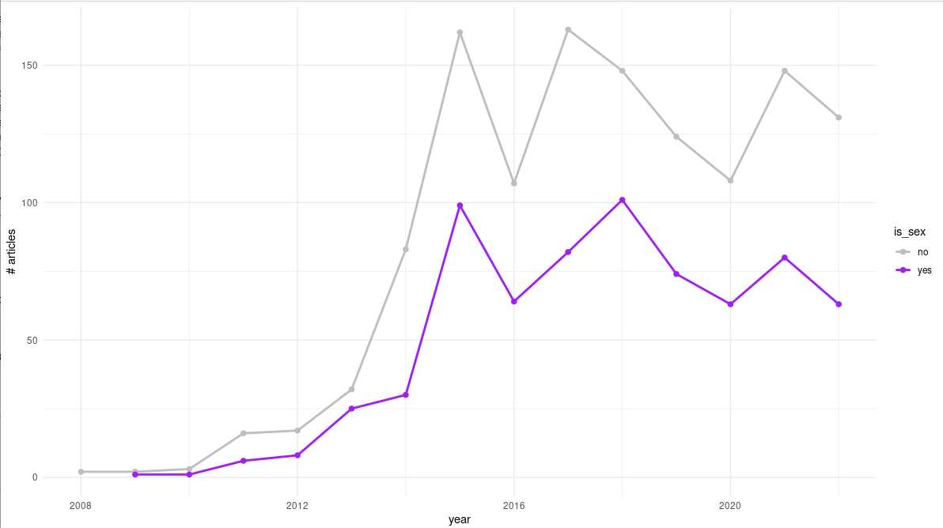
Number of studies reporting the sex of their samples
Sex of the samples
# articles
year

Slide 8
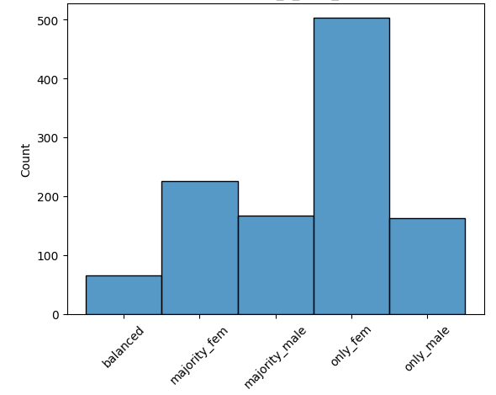
Sex representation by categories

Slide 9
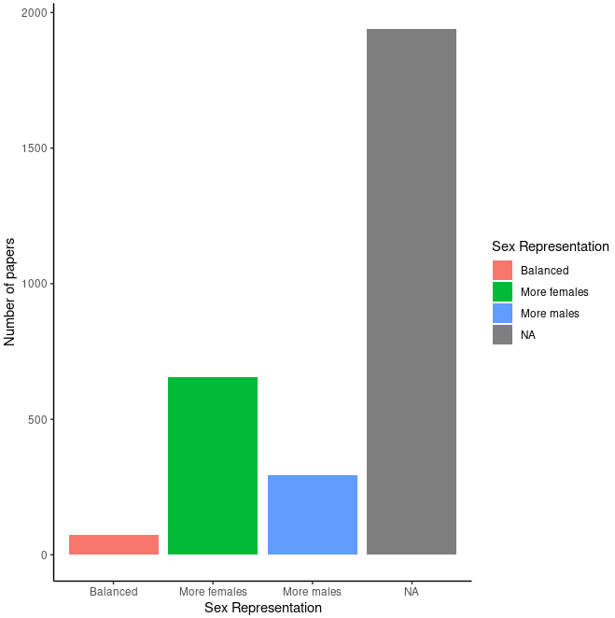
Sex representation with EU funding

Slide 10
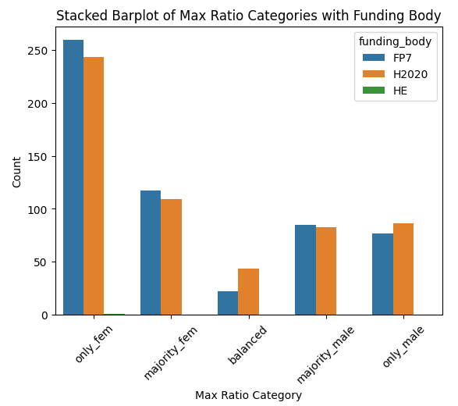
Sex representation by categories and funding body
slight increase

Slide 11
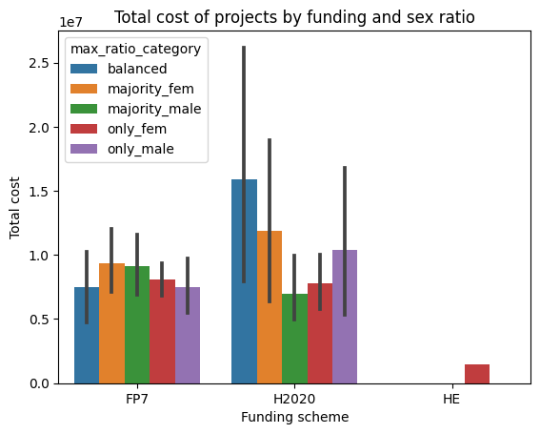
Sex representation by categories and total cost

Slide 12
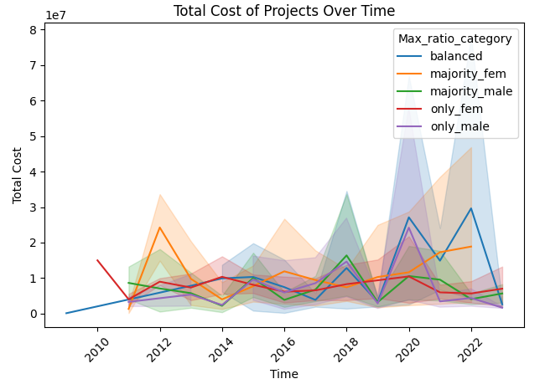
Total cost of EU projects by sex ratio category over time

Slide 13
Total cost of EU projects by sex ratio category over time
higher cost

Slide 14
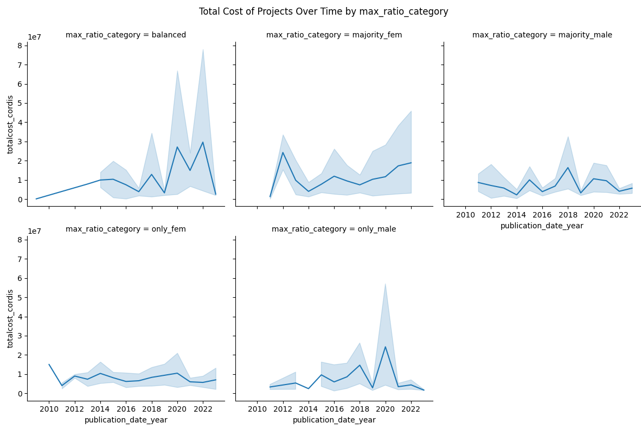
Total cost of cordis projects over time segregating by sex ratio category

Slide 15
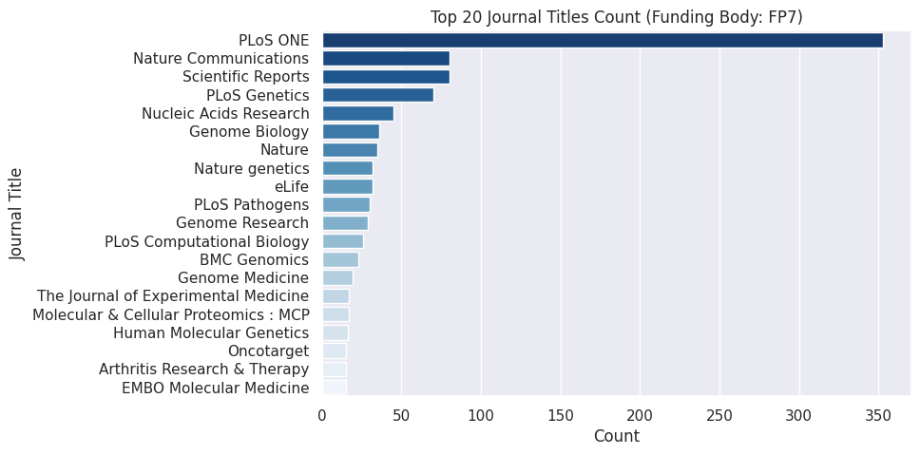
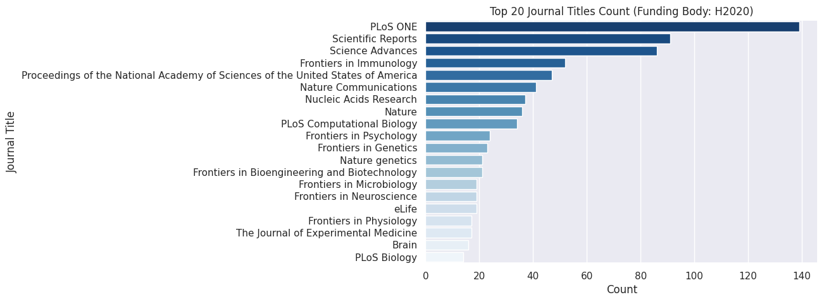
Journal title
FP7
HORIZON2020

Slide 16
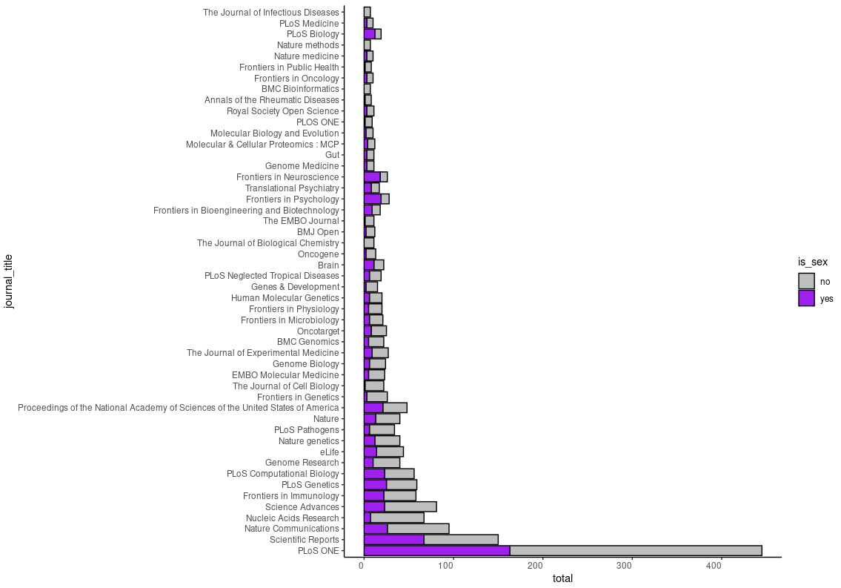
Journal title
Sex of the samples

Slide 17
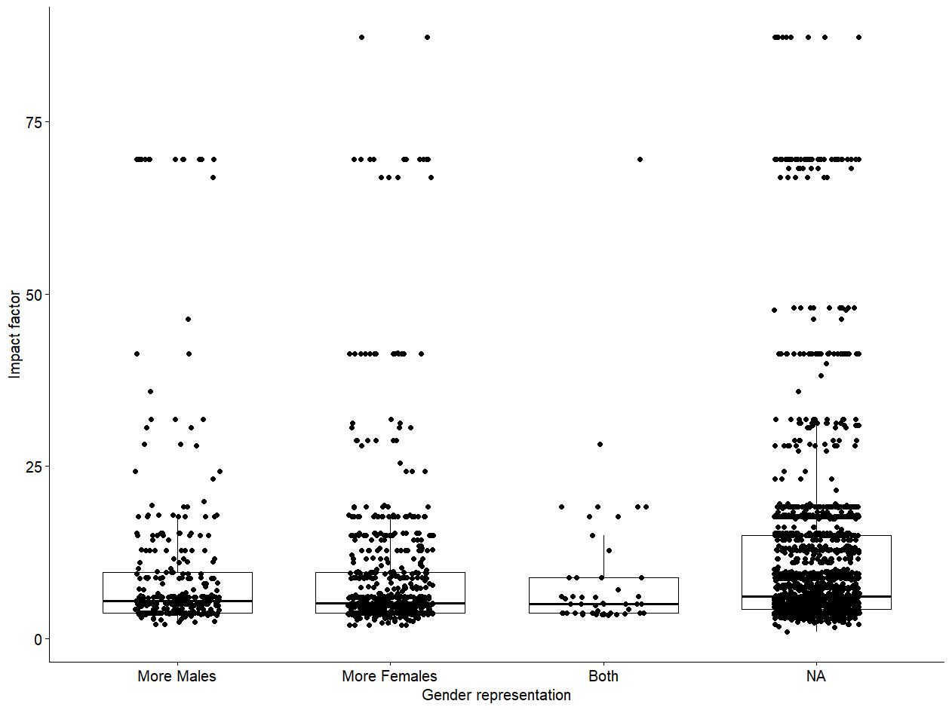
WG3 - Impact factor vs. sex representation with EU funding
Notes:
Sex representation.
T-test-

Slide 18
WG3 - Gender of authors vs. sex representation with EU funding
Name and surname of the authors
Gender of the authors
+
Confidence score
Notes:
María, algo que podamos poner en la slide?

Slide 19
MeSH qualifiers
Script to retrieve from PMCIDs:
MeSH term:
Topical descriptor
Qualifier
Tree number
Notes:
Identify areas of research with

Slide 20
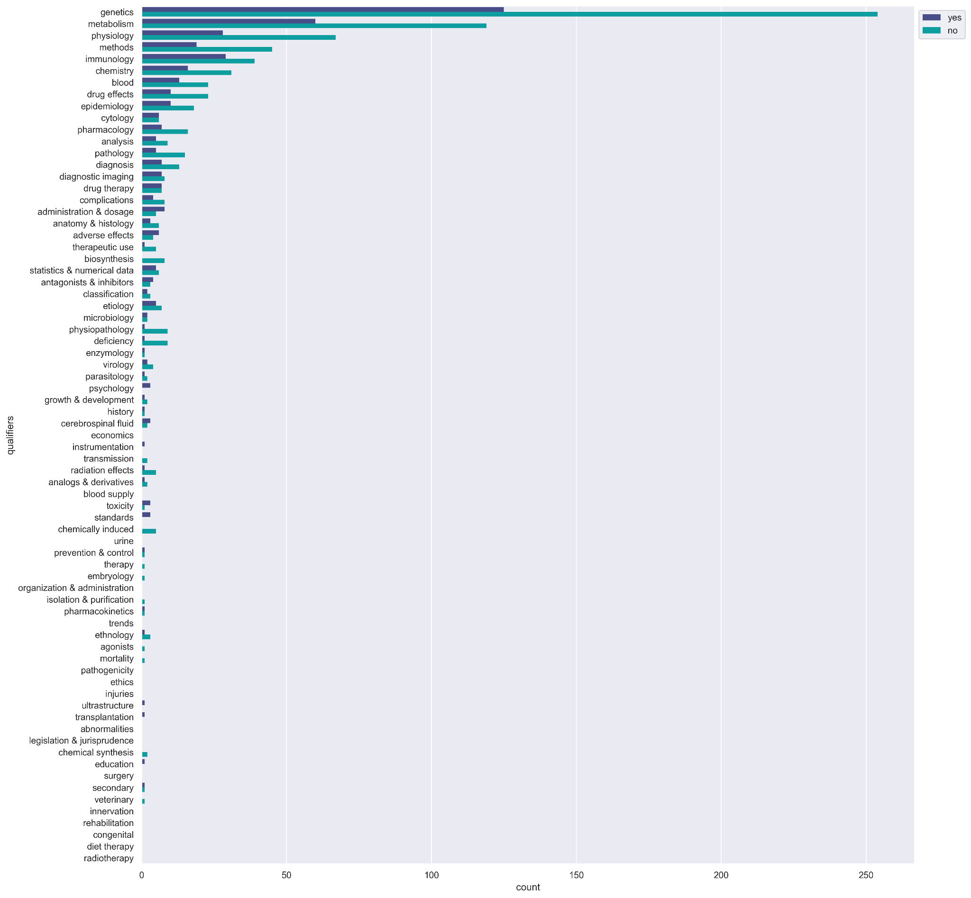
MeSH qualifiers
Top MeSH qualifiers from CORDIS
Stratifying by inclusion of gender info
Script to retrieve from PMCIDs:
MeSH term:
Topical descriptor
Qualifier
Tree number
Notes:
Identify areas of research with

Slide 21
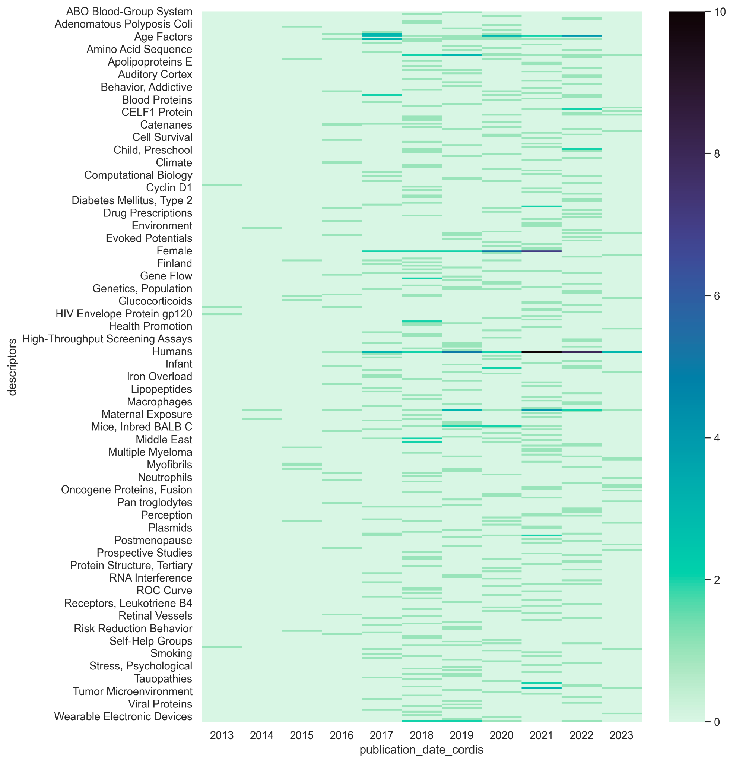
MeSH qualifiers
Evolution of Descriptors along CORDIS
Only PMCIDs with sex counts
Notes:
Identify areas of research with

Slide 22
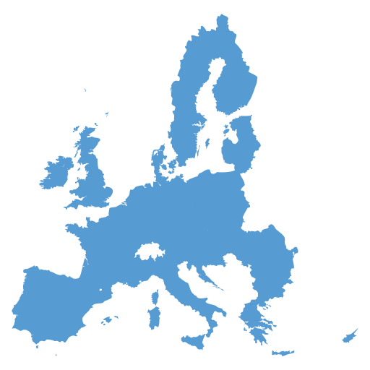


WG5 - US funding (NIH)
Different data format compared to CORDIS
Much more detailed information
Hard to extract the data compared to EU funding
Around 21k articles with US funding
7k with sex representation data (33%, the same as in the EU)

Slide 23
In summary…
It’s hard to explore sex representation from articles text
It’s hard to relate funding data
However…
based on this preliminary analysis, we think it’s something viable to be analyzed and useful and needed!.
Still, we need more time, help and ideas!

Slide 24
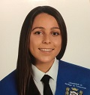
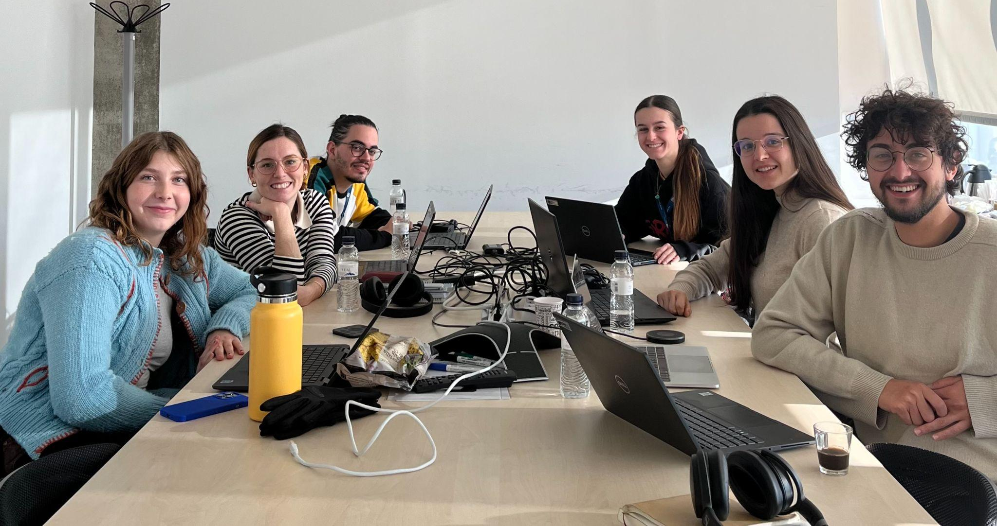



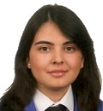
Thanks to collaborators during the BHG23
Roman – MeSH terms
People suggesting go to sci-hub for private publications (xD)
All participants that gave their support, point of view, ideas and showed interest in our topic!

Slide 25
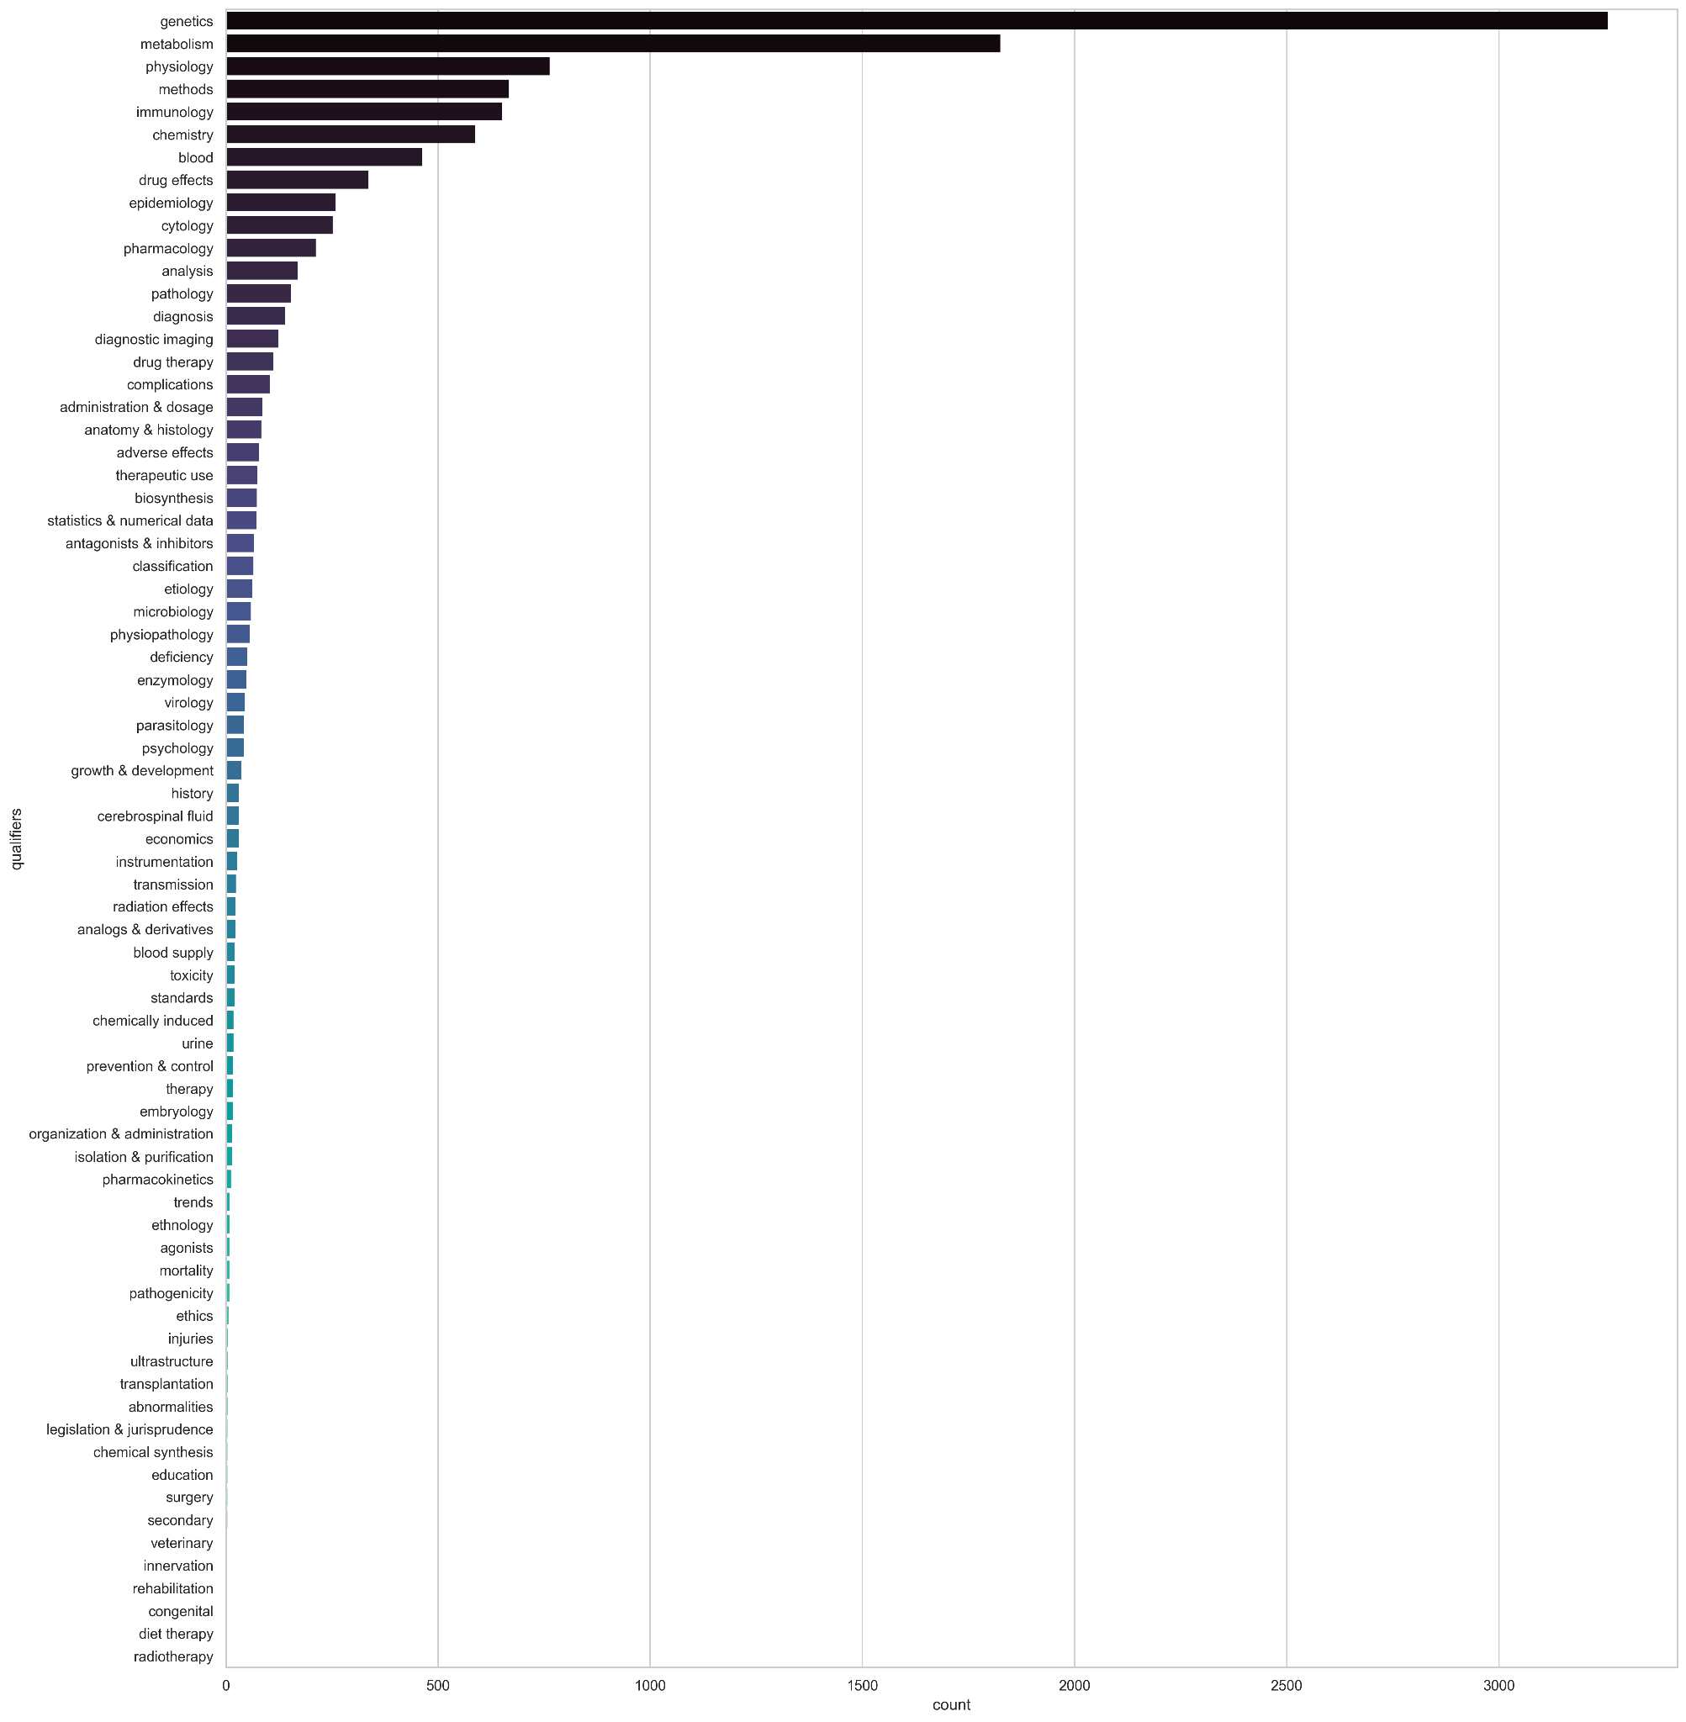
MeSH qualifiers
Top MeSH qualifiers from CORDIS
All PMCIDs
Idea:
make a dendrogram of publications
Notes:
Identify areas of research with

Slide 26
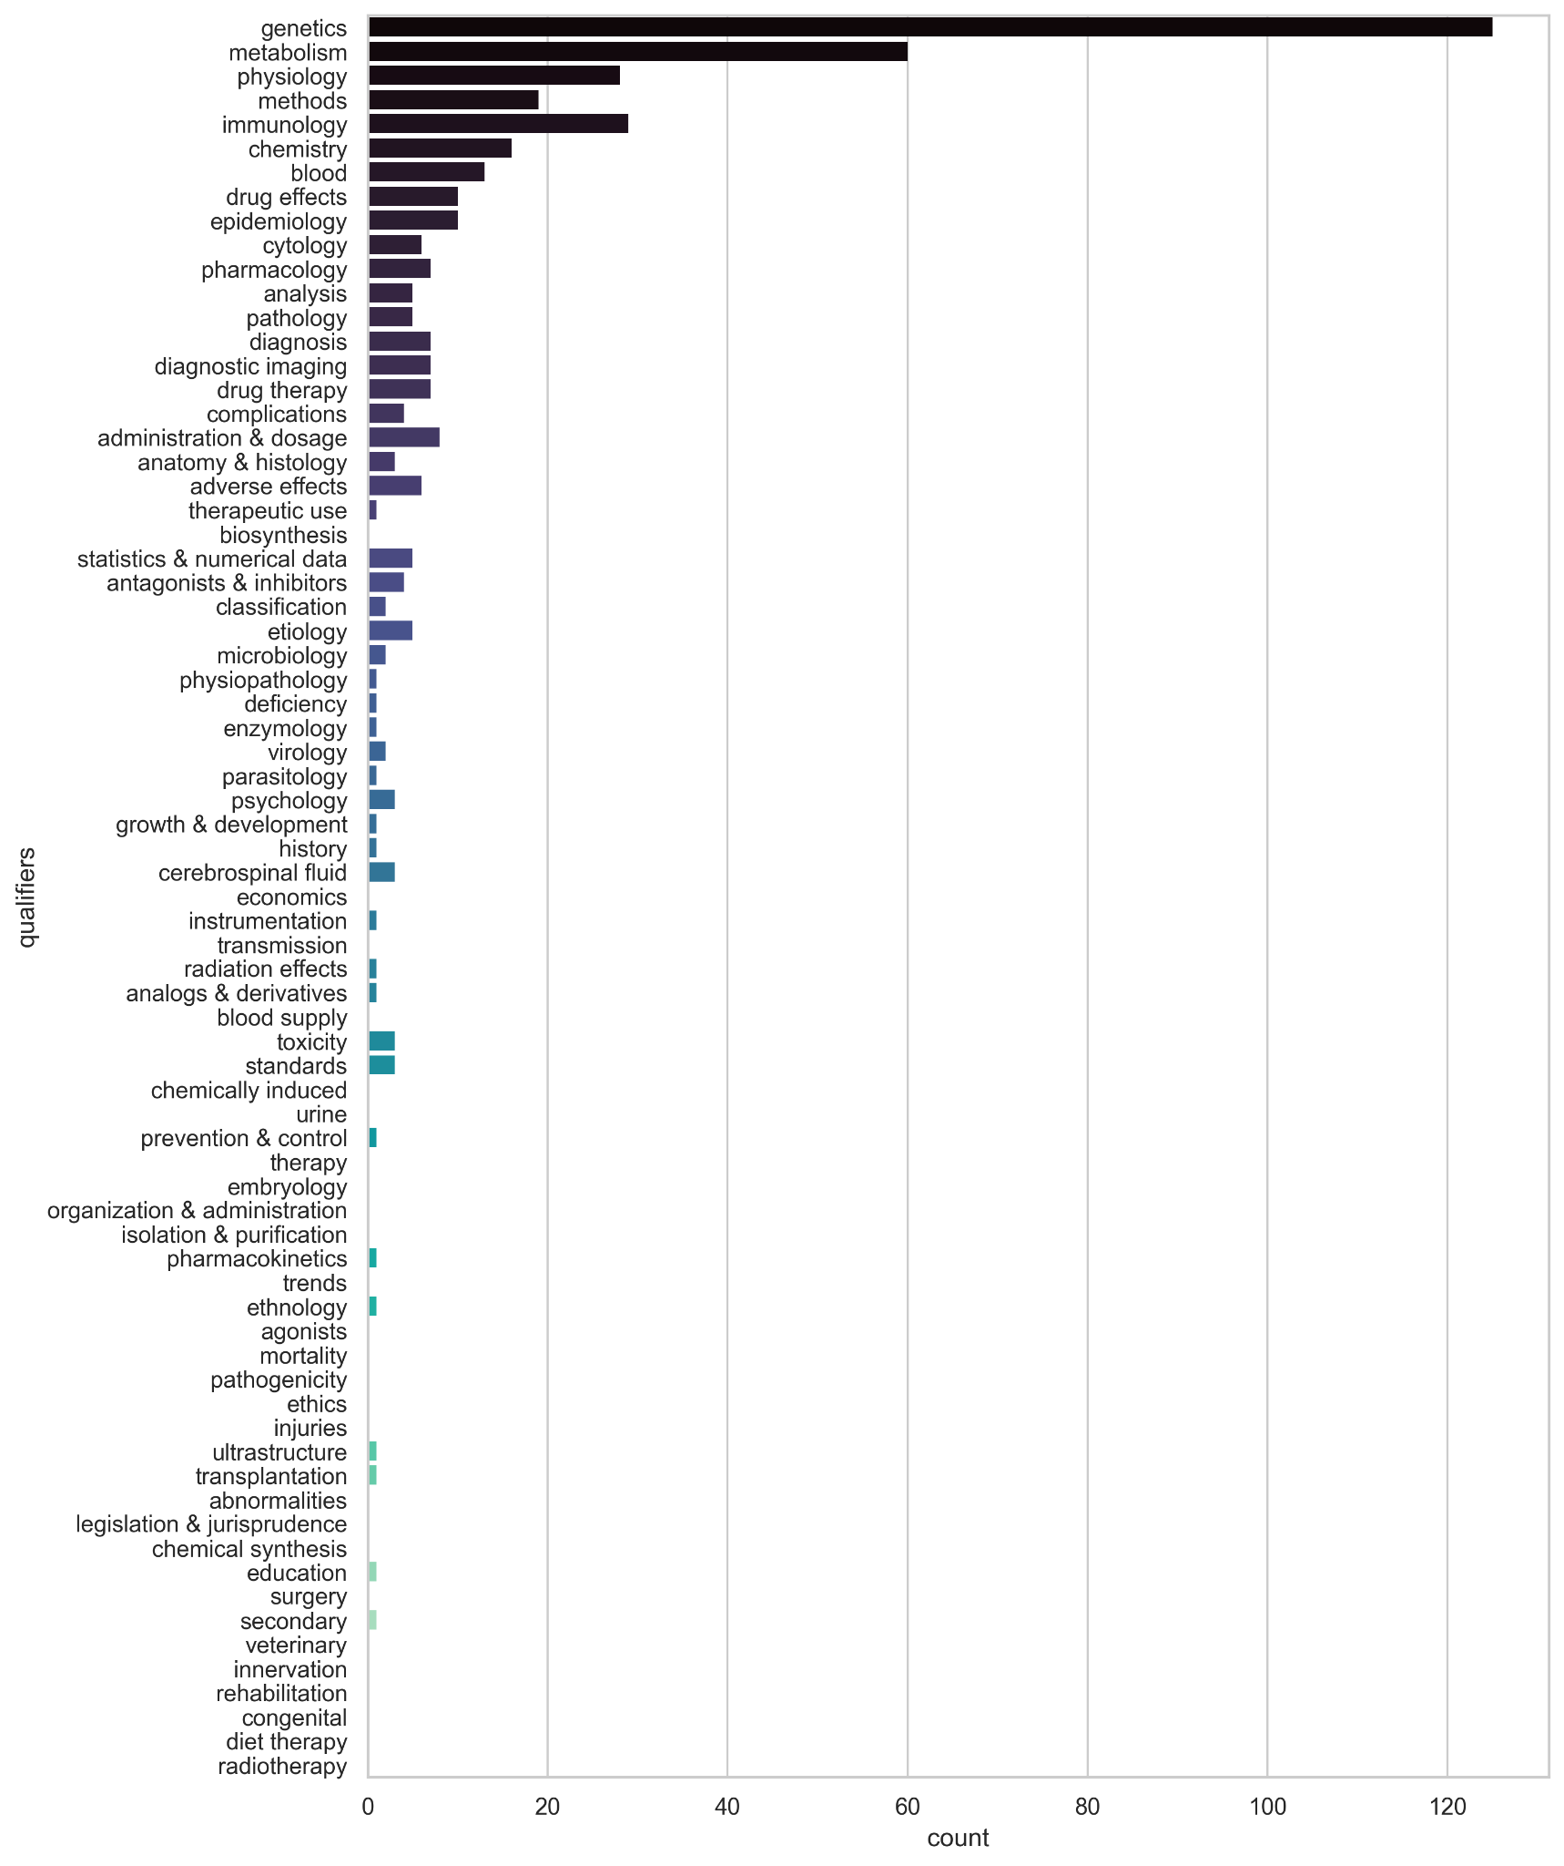
MeSH qualifiers
Top MeSH qualifiers from CORDIS
Only PMCIDs with sex counts
Idea:
make a dendrogram of publications
Notes:
Identify areas of research with

Slide 27
MeSH qualifiers
Top MeSH qualifiers from CORDIS
Stratifying by inclusion of gender info
Notes:
Identify areas of research with

Slide 28
WG4 - MeSH terms
Goal: explore content of articles for which we have funding and sex representation data.

Slide 29
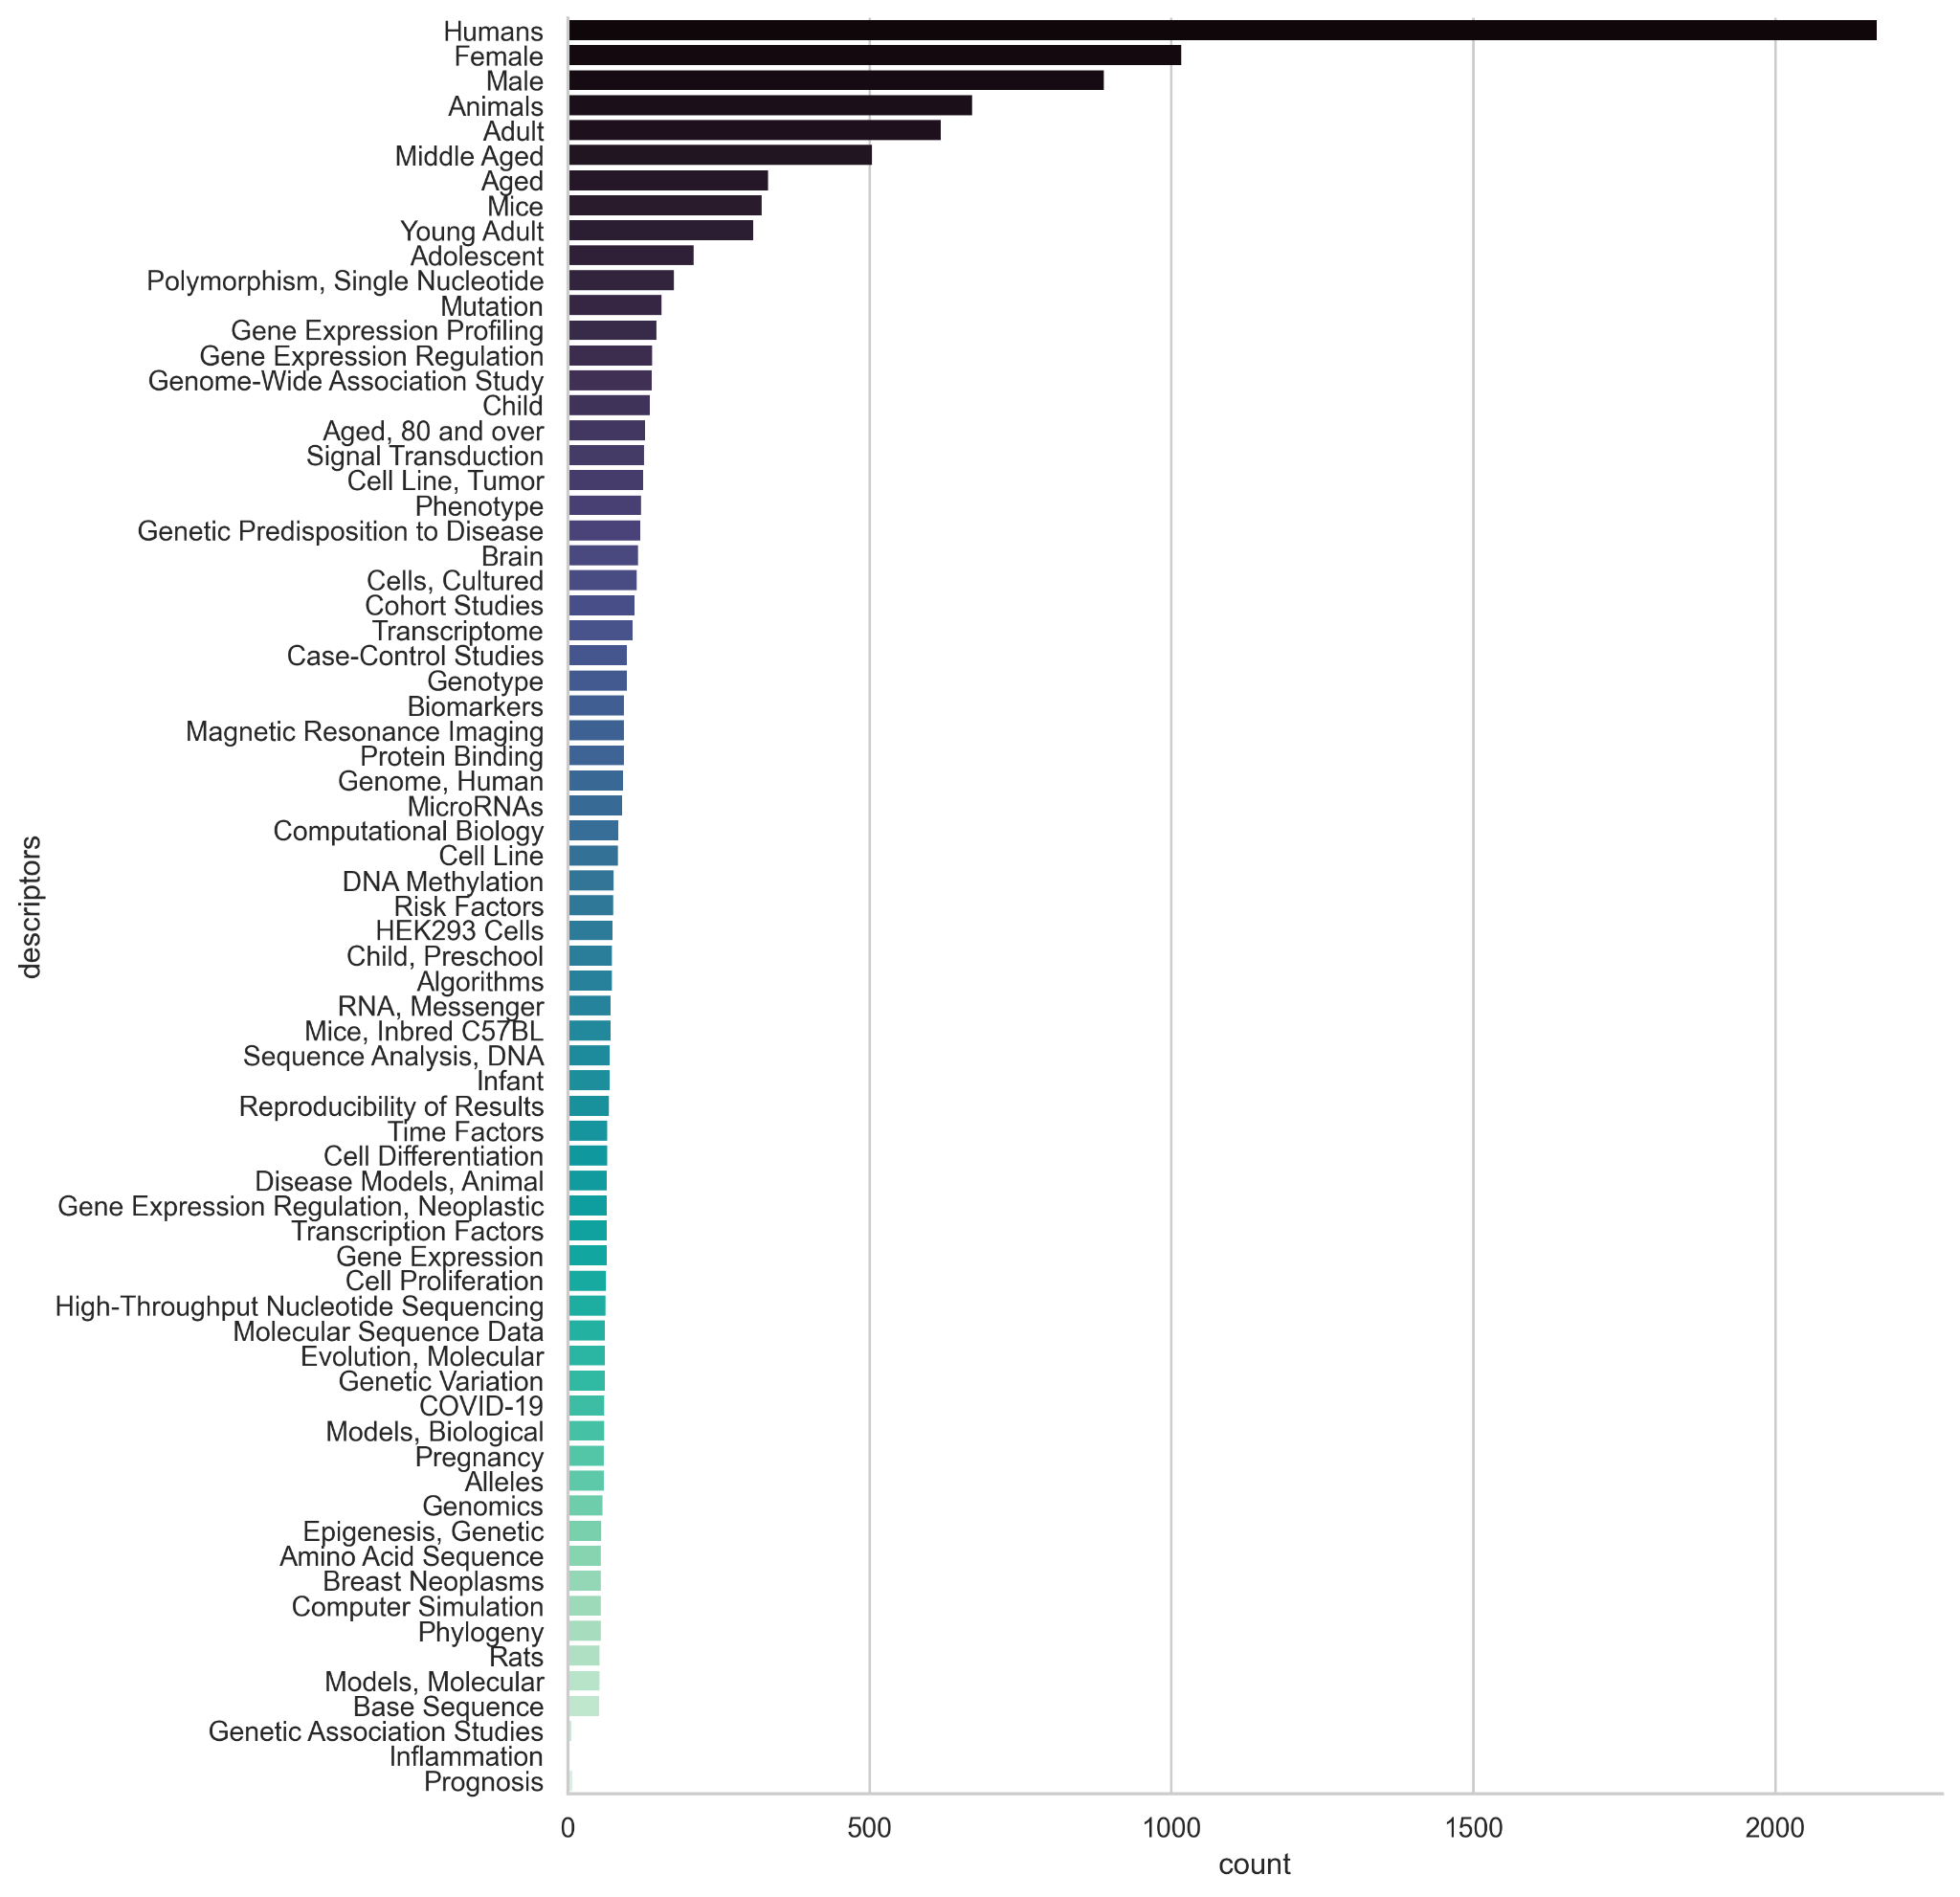
MeSH qualifiers
Top MeSH descriptors from CORDIS
All PMCIDs
Idea:
make a dendrogram of publications
Notes:
Identify areas of research with

Slide 30
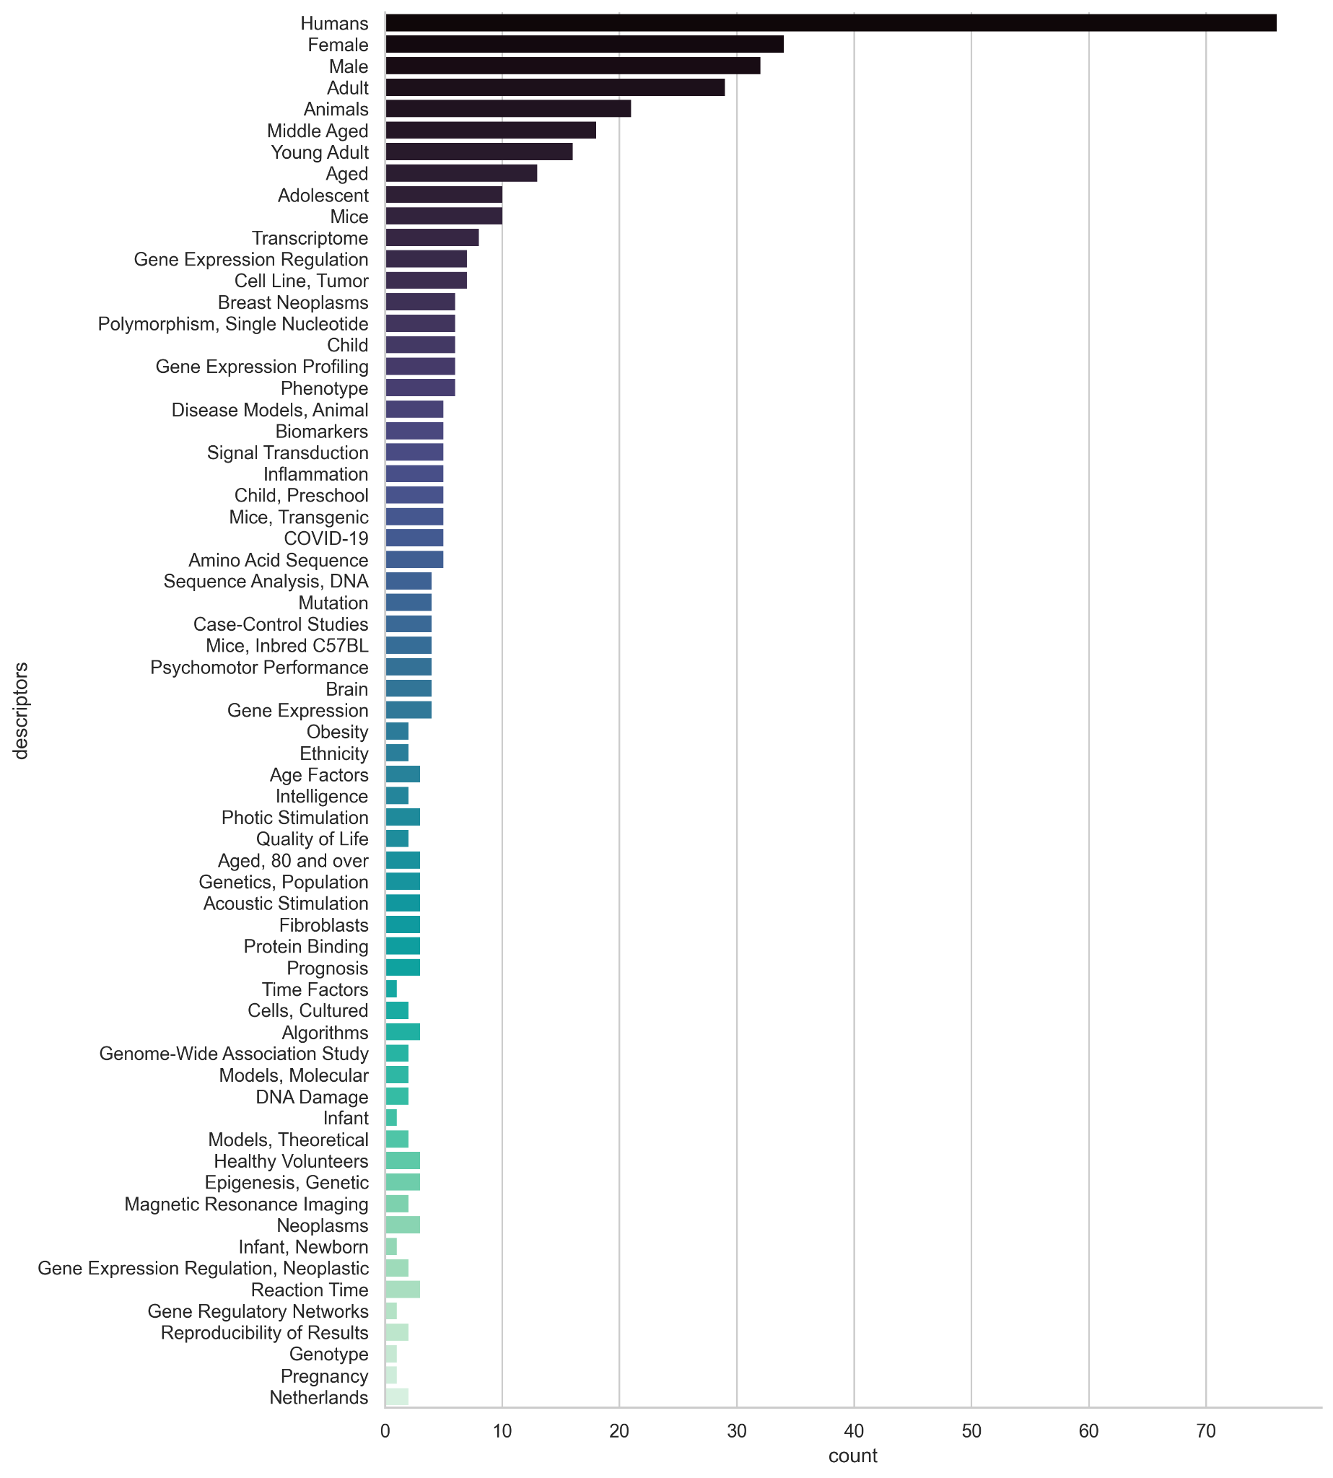
MeSH qualifiers
Top MeSH descriptors from CORDIS
Only PMCIDs with sex counts
Idea:
make a dendrogram of publications
Notes:
Identify areas of research with

Slide 31
MeSH qualifiers
Notes:
Identify areas of research with

Slide 32
MeSH qualifiers
Evolution of Descriptors along CORDIS
Only PMCIDs with sex counts
Notes:
Identify areas of research with

Slide 33
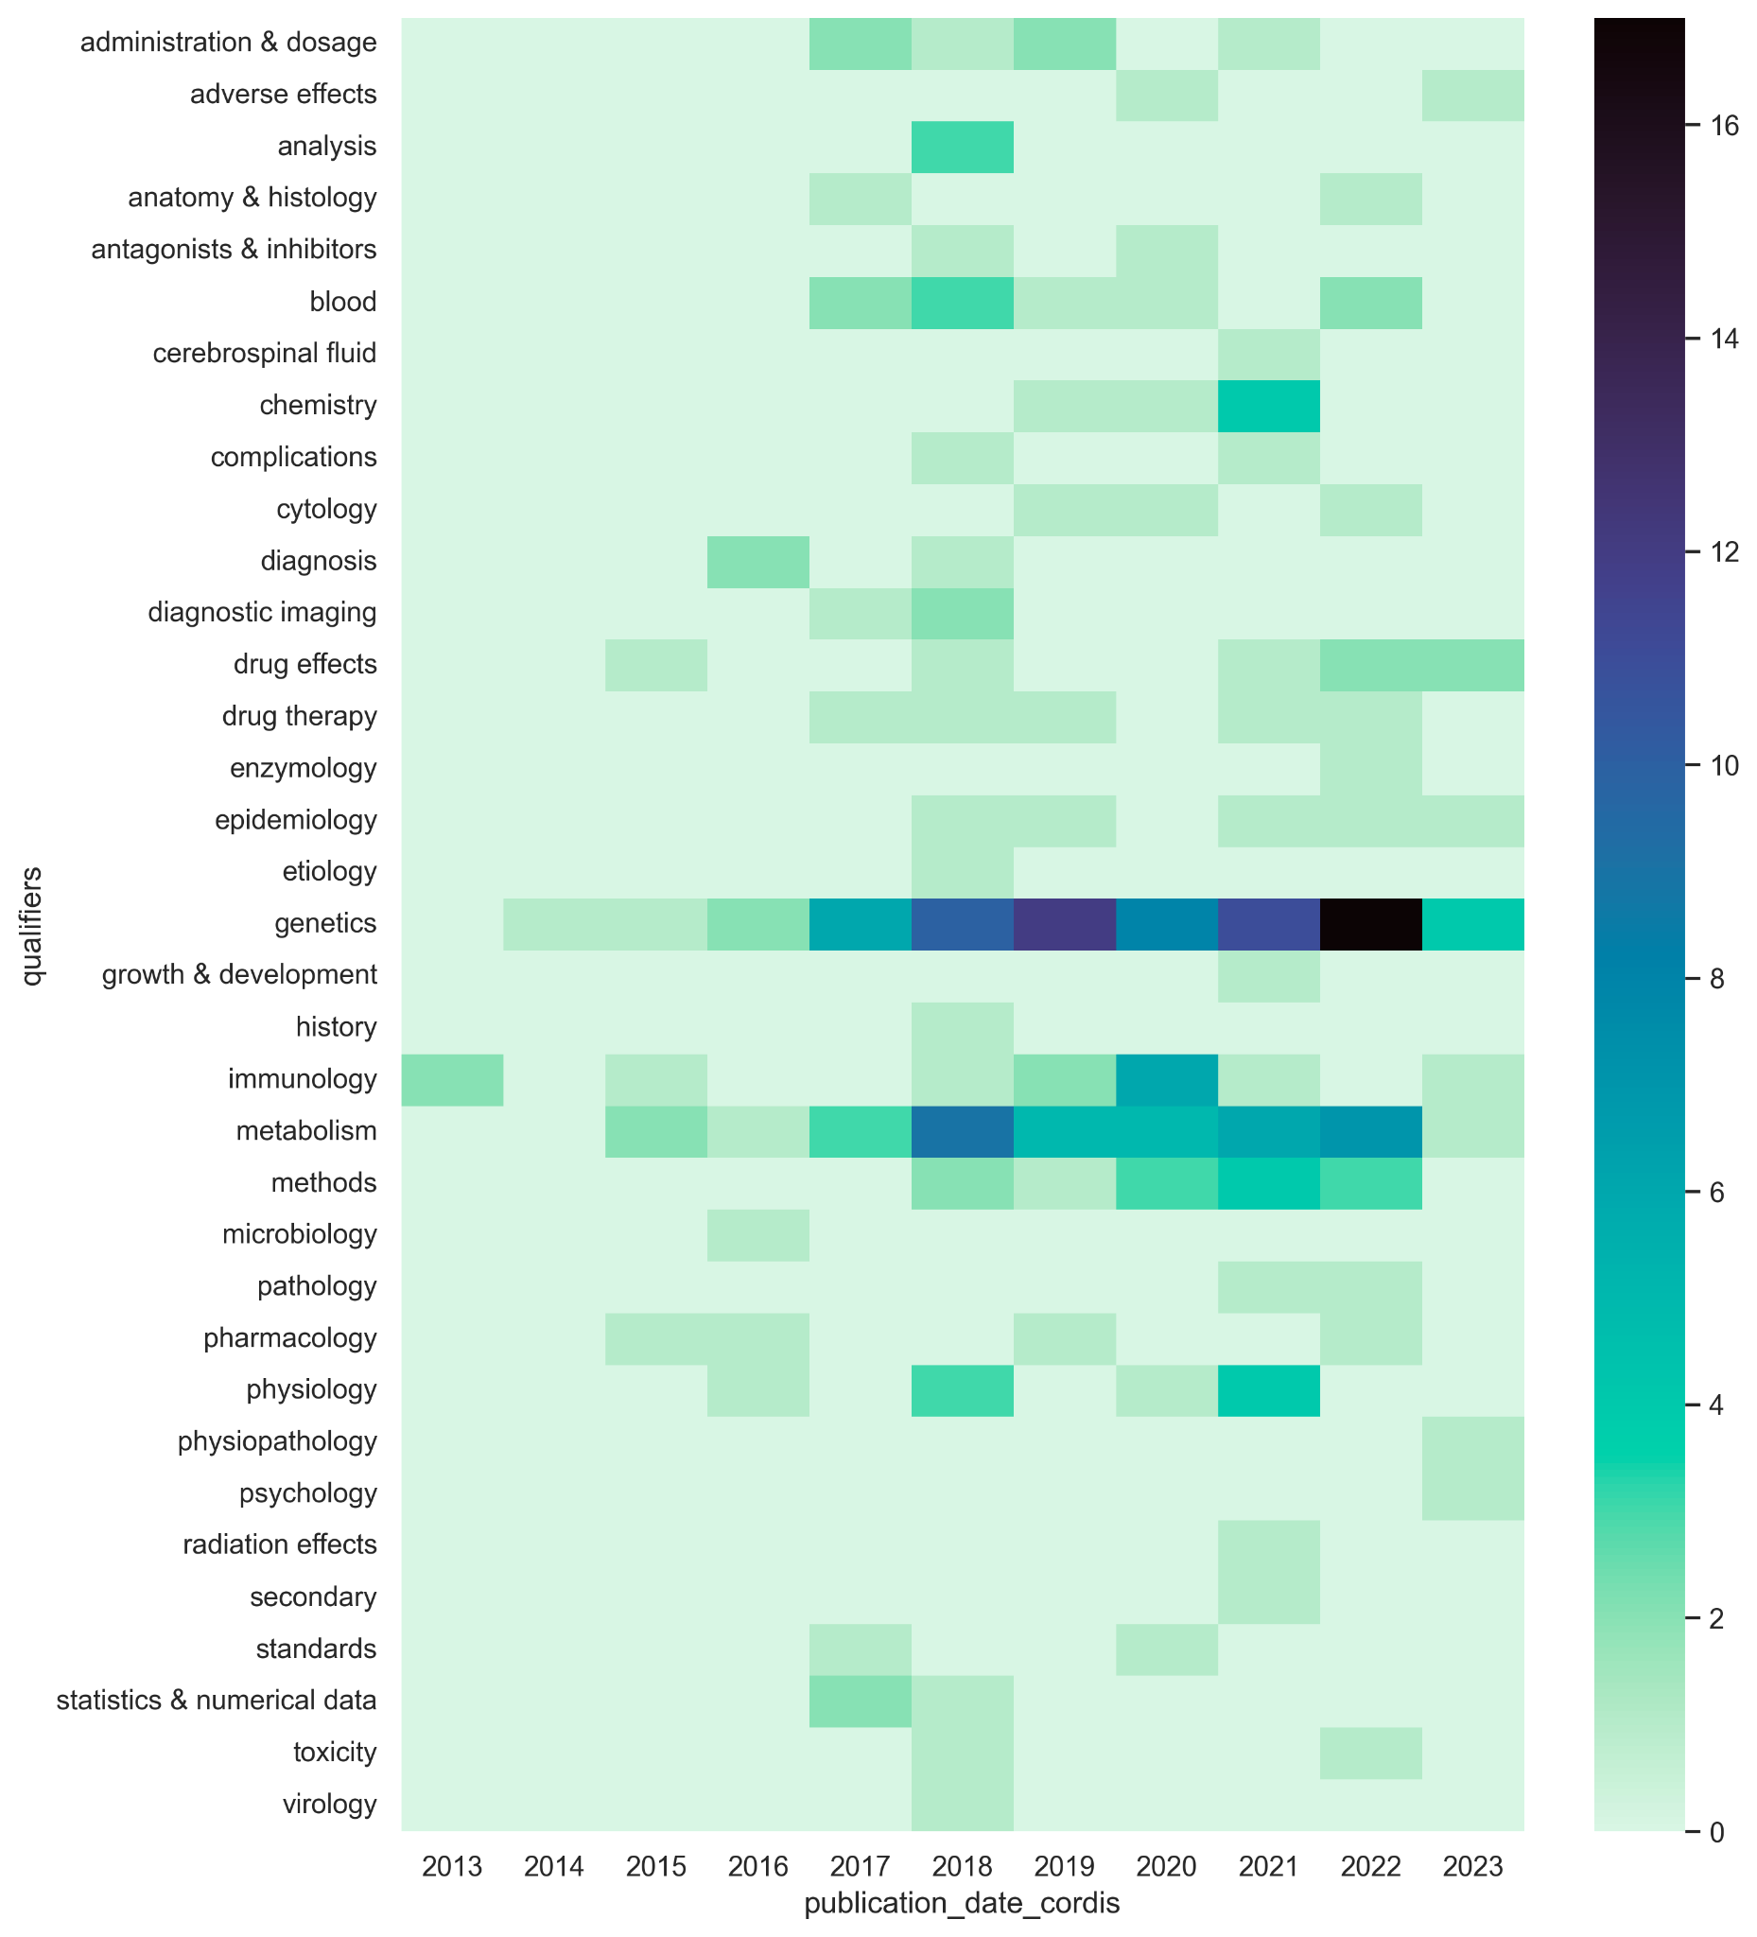
MeSH qualifiers
Evolution of Qualifiers along CORDIS
Only PMCIDs with sex counts
Notes:
Identify areas of research with

Slide 34
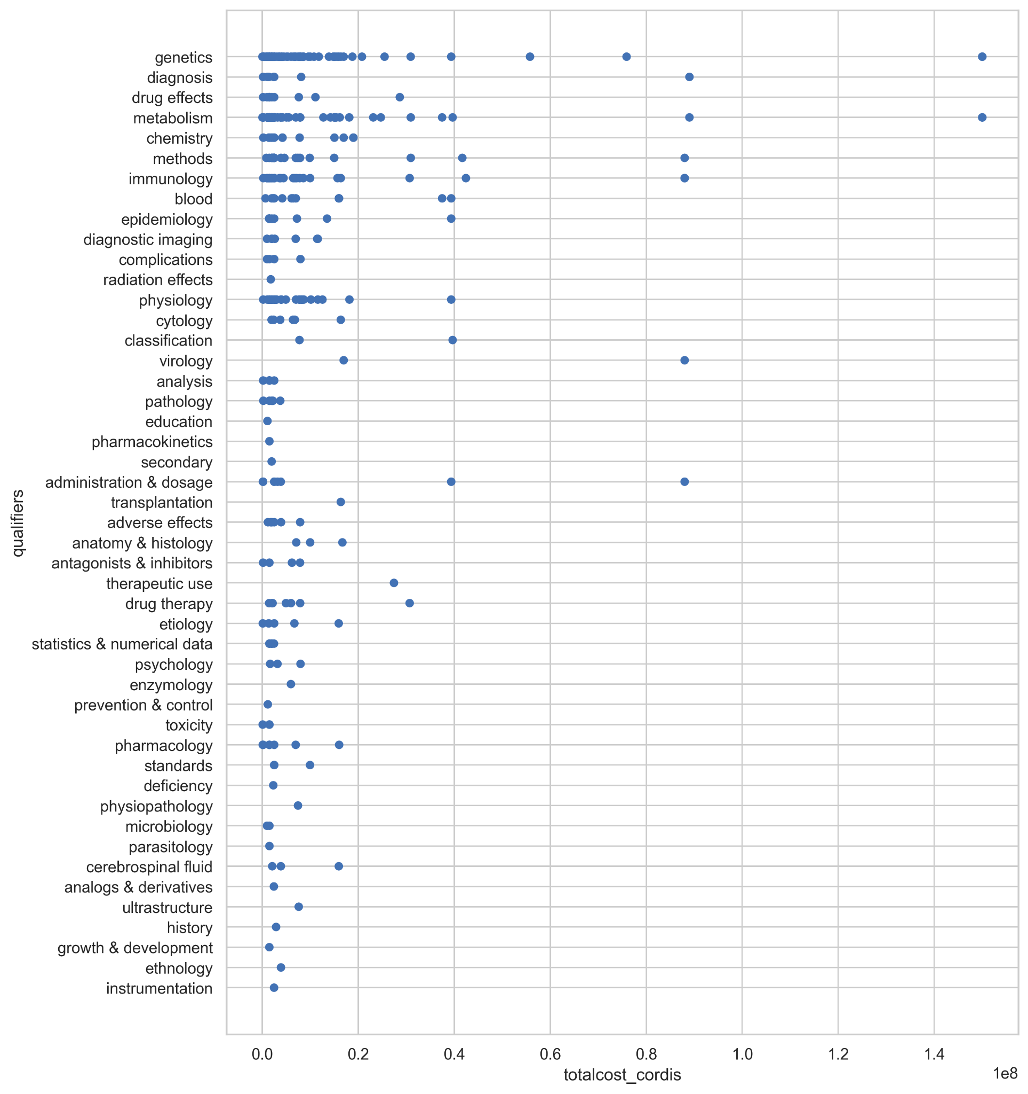
MeSH qualifiers
Qualifiers and funding
Only PMCIDs with sex counts
Notes:
Identify areas of research with

Slide 35
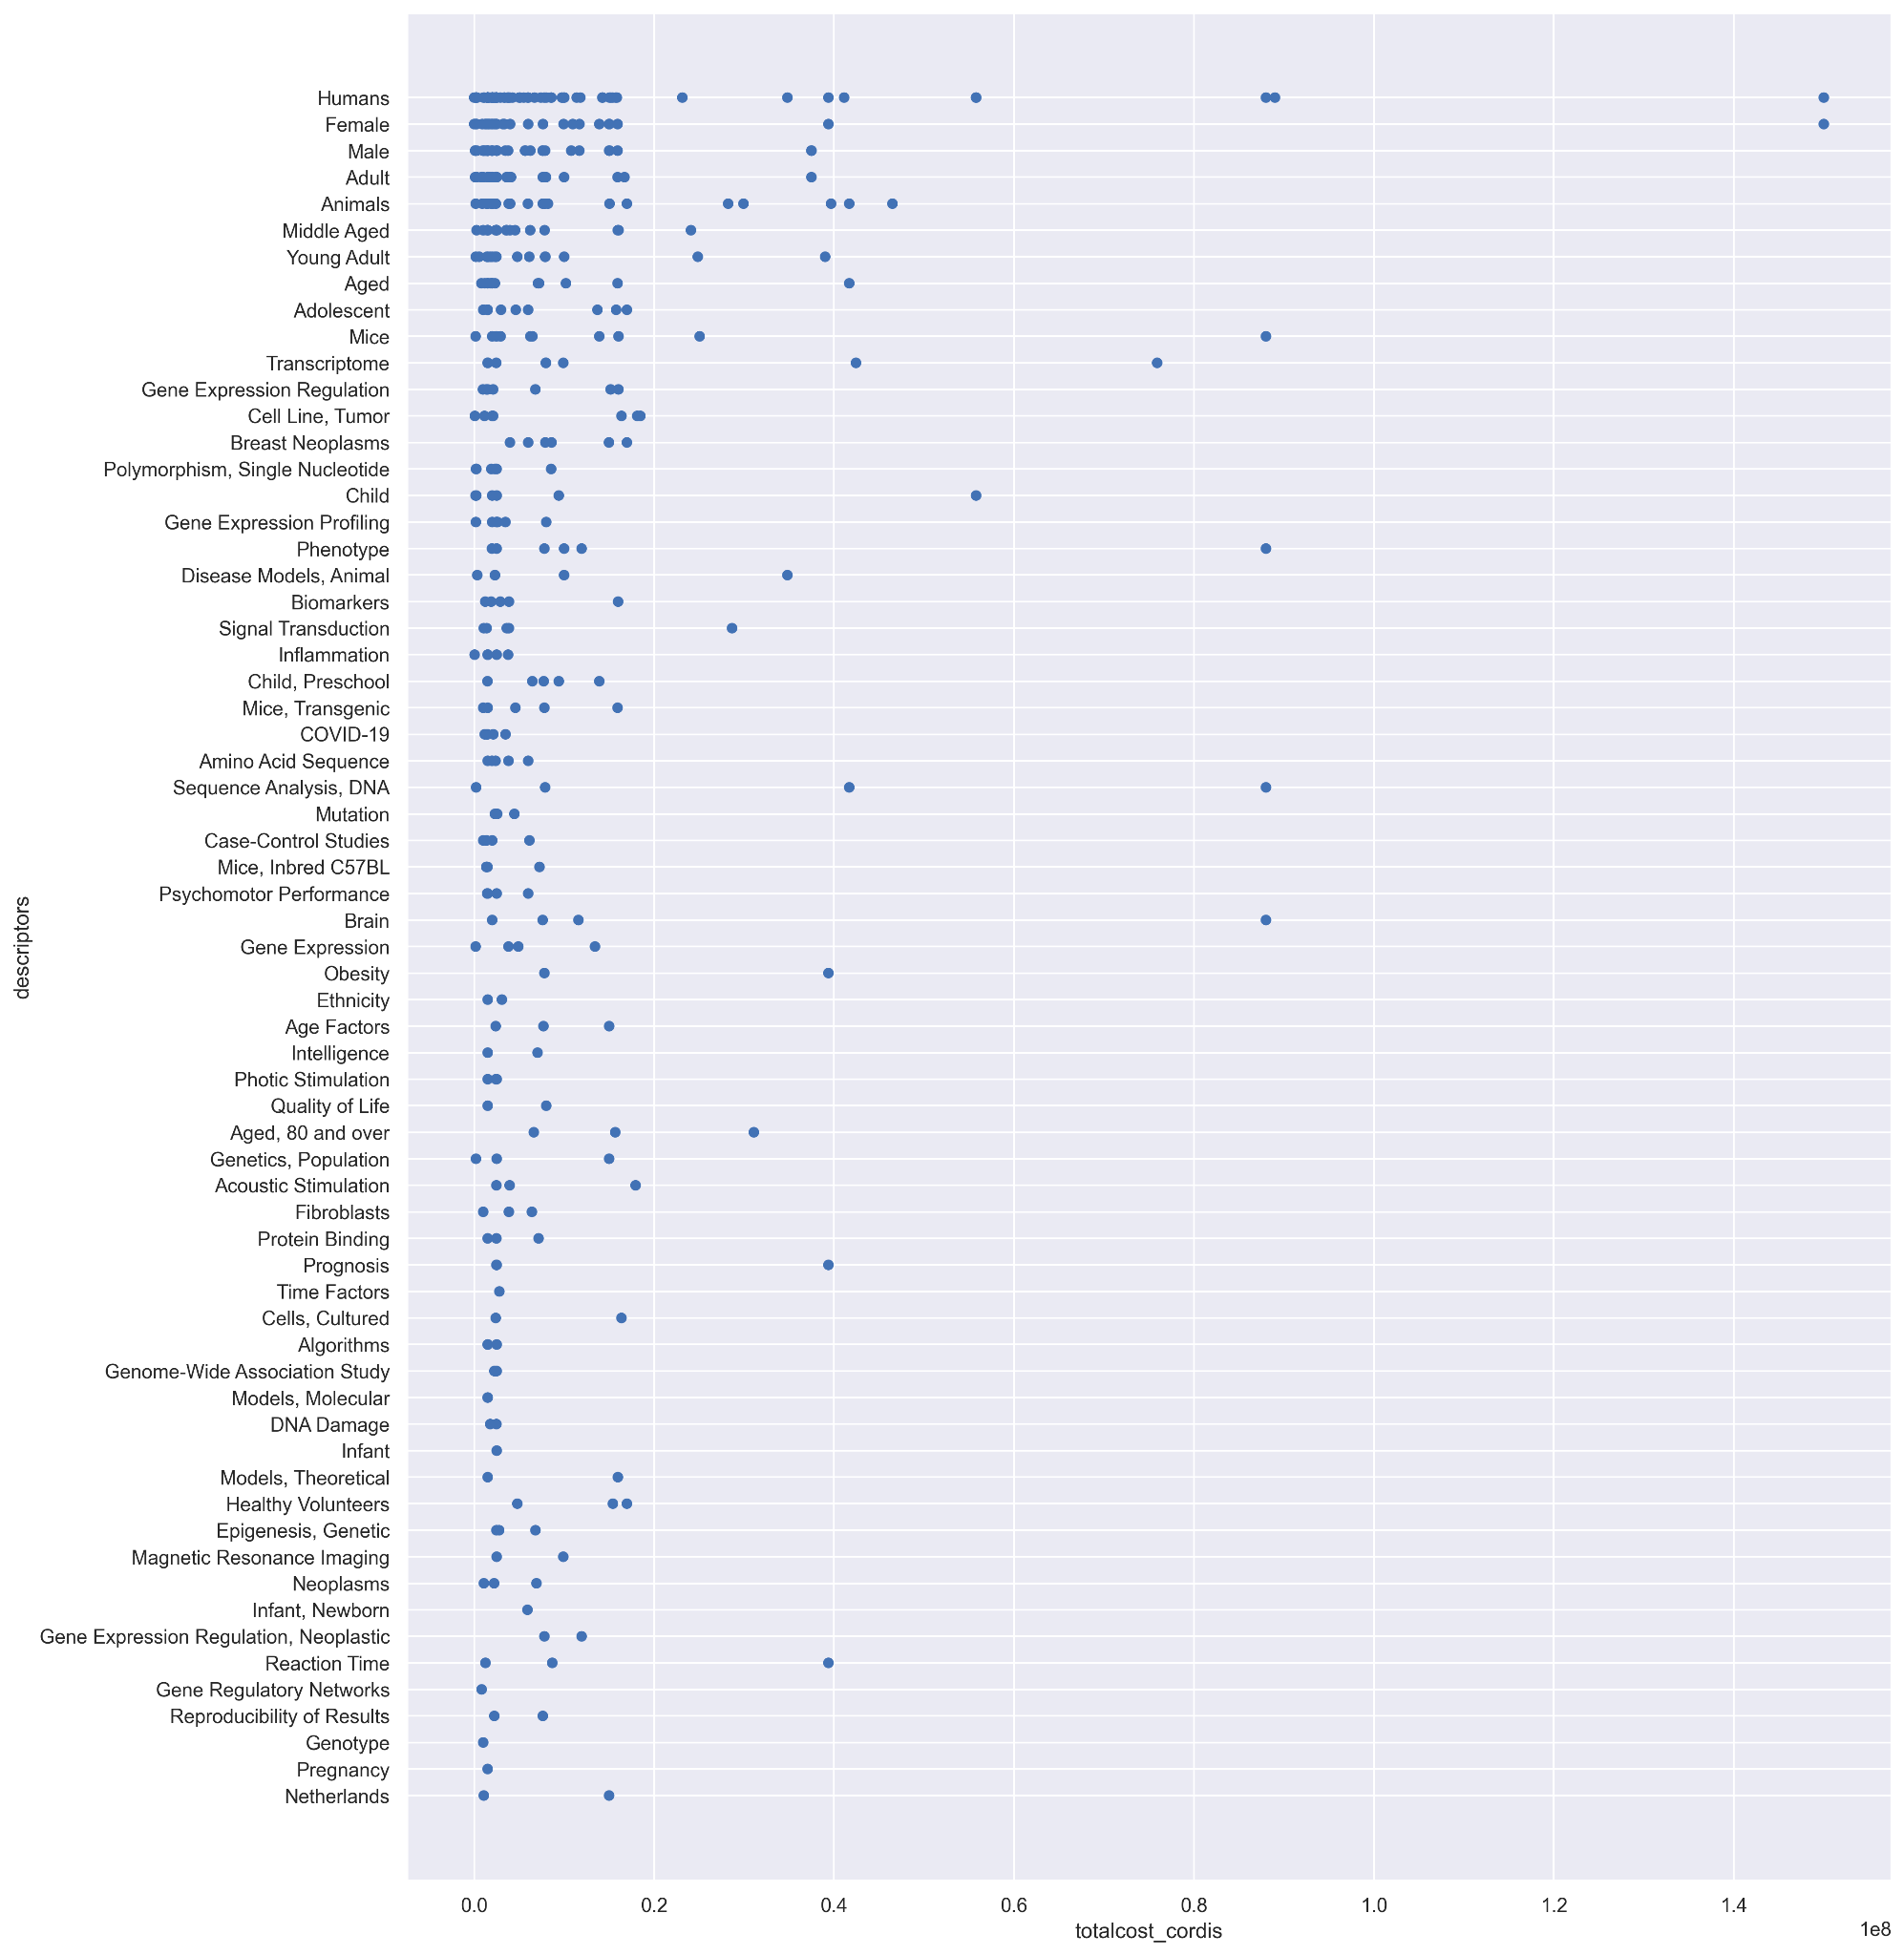
MeSH qualifiers
Most common descriptors and funding
Only PMCIDs with sex counts
Notes:
Identify areas of research with

